Slide 1
Chapters 1, 2 and 3 Variables, Expressions, Statements, Functions

Slide 2
Python Programming Language
Python is an open-source and increasingly popular, general-purpose language.
It is a high-level and interpreted language.
Almost all programs are written in high-level languages.
Examples of a high-level languages: C, C++, Perl, and Java.
Computers can only execute programs written in low-level languages, sometimes referred to as “machine languages” or “assembly languages”.
Thus, programs written in a high-level language have to be processed before they can run. This extra processing takes some time, but it is a small disadvantage of high-level languages compare to enormous advantages:
Easier to program and read. In a high-level language, very few words represent many lines of low-level language.
Programs written in high-level languages are portable.

Slide 3
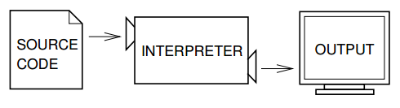
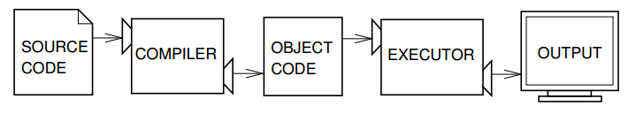
Python Programming Language Cont.
Two kinds of programs process high-level languages into low-level languages: interpreters and compilers.
An interpreter reads a high-level program and translates it into system commands on the fly.
Most scripting languages, like Python and JavaScript, are interpreted.
A compiler reads the program and translates it completely before the program starts running. The translated program is called the object code or the executable. Once a program is compiled, you can execute it repeatedly without further translation.

Slide 4
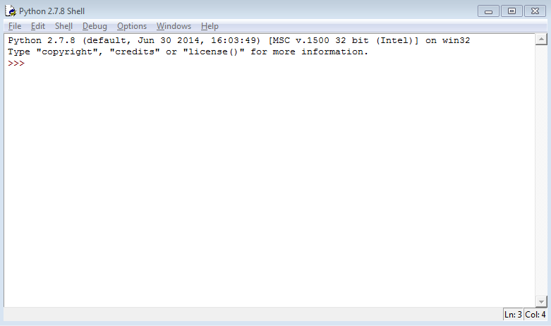
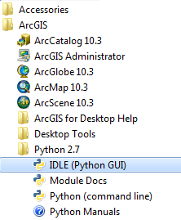
Python IDE
You can write Python code on any Python editor known as integrated development environments (IDEs). A list of Python editors can be found on the Python wiki page: https://wiki.python.org/moin/IntegratedDevelopmentEnvironments
IDLE (Integrated DeveLopment Environment) is the default Python IDE and is installed with the ArcGIS installation: IDLE (Python GUI). GUI stands for graphical user interface.
The Python shell window.

Slide 5
Python Shell Window
There are two ways to use the interpreter: command-line mode and script mode.
In command-line mode, you type Python code in the Python Shell window after the prompt of the interactive Python interpreter >>>.
When you are done writing the code, press Enter and Python interpreter will execute your command.
Python Shell window is used to:
quickly test lines of codes without saving that code
view error messages from scripts
view the output from print statements
Code written to Python Shell window is not meant to be saved.

Slide 6
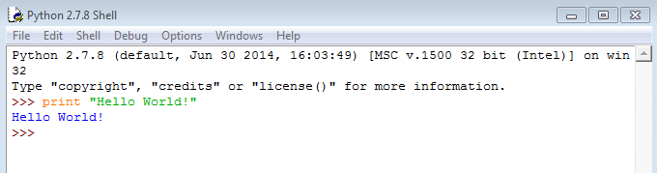
Python Shell Window Cont.
Python interpreter highlights the code you type based on how it is interpreting your input.
Orange is for statements and green is for strings.
This is called syntax highlighting and it is helpful during error checking.
Syntax highlighting conventions vary between Python editors.

Slide 7
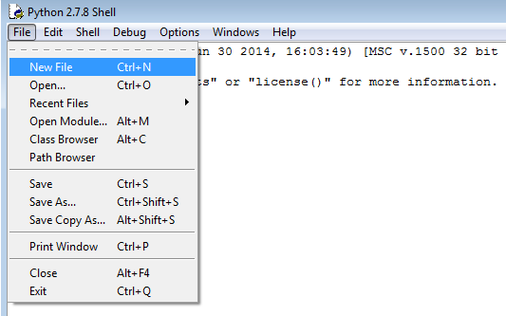
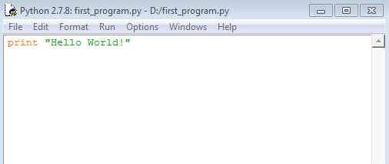
Python Scripts
A program is a sequence of instructions that specifies how to perform a computation.
In script mode, you can write a program in a file and use the interpreter to execute the contents of the file. Such a file is called a script. By convention, files that contain Python programs have names that end with .py.
Your scripts will be written in IDLE inside a separate window known as the Python script window.
Before you run a script, you need to save it.
Python script window

Slide 8
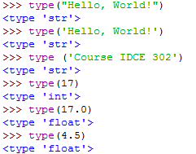
Data Types
Python uses a number of different data types, including strings and numbers.
Strings contain one or more characters, which can include letters, numbers, or other types of characters.
You (and the interpreter) can identify strings because they are enclosed in quotation marks, even if they are numbers.
Numbers can be:
integers (whole numbers that have no fractional part)
floats (have a decimal point)

Slide 9
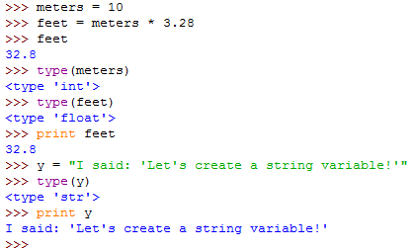
Variables
A variable is a name that refers to a value. Variables are used to store information.
The assignment statement creates new variables and gives them values. Once you assign a value to a variable, you can use the variable in an expression.
In general, single and double quotes do the same thing, but if the string contains a single quote (or an apostrophe, which is the same character), you have to use double quotes to enclose it.
Python does not require you to declare a variable and define its type, before you can assign a value to it. You can change the type of a variable by assigning it a new value. This is known as dynamic assignment.

Slide 10
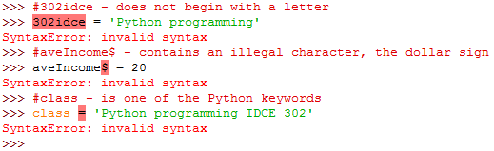
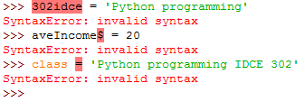
Variable Names
The names that you choose for variables should be meaningful, descriptive of what is storing, not very long, and possibly include the type of data they represent.
Variable names can be arbitrarily long. They can contain letters, numbers and underscores ( _ ), but they have to begin with a letter, should not contain illegal characters or be a keyword used by Python.
Python is a case sensitive programming language. These are different variables:
Income and income
averagewage and averageWage
Maintain a standard practice in assigning names to variables in your program.
Style Guide for Python Code: https://www.python.org/dev/peps/pep-0008/

Slide 11
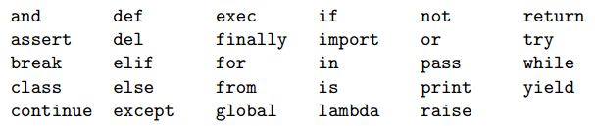
Keywords
The interpreter uses keywords to recognize the structure of the program, and they cannot be used as variable names.
Below is a list of keywords used by Python:

Slide 12


Statements and Expressions
A statement is an instruction that the Python interpreter can execute such as print and assignment. Statements do something.
A script usually contains a sequence of statements.
An expression is a combination of values, variables, and operators. Not every expression contains all of these elements. A value all by itself is considered an expression, and so is a variable.
If you type an expression on the command line, the interpreter evaluates it and displays the result.
Technically an expression is also a statement, but it is probably simpler to think of them as different things. The important difference is that an expression has a value; a statement does not.

Slide 13
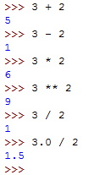
Operators and Operands
Operators are special symbols that represent computations like addition and multiplication.
The values the operator is applied to are called operands.
The operators +, -, *, / and ** perform addition, subtraction, multiplication, division and exponentiation
When both of the operands are integers, the result must also be an integer. It is referred to as integer division.
If we want floating-point division, referred to as true division, at least one of the inputs must be a floating-point number.

Slide 14
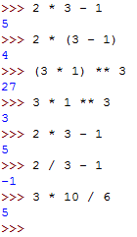
Order of Operations
When more than one operator appears in an expression, the order of evaluation depends on the rules of precedence. Python follows the same precedence rules for its mathematical operators that mathematics does.
The acronym PEMDAS is a useful way to remember the order of operations:
P - Parentheses have the highest precedence and can be used to force an expression to evaluate in the order you want.
You can also use parentheses to make an expression easier to read, even when it doesn’t change the result.
E - Exponentiation has the next highest precedence.
M - Multiplication and D - Division have the same precedence, which is higher than A - Addition and S - Subtraction, which also have the same precedence.
Operators with the same precedence are evaluated from left to right.

Slide 15
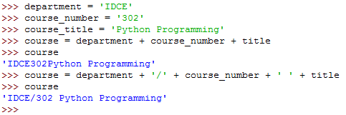

String Operations
In general, you cannot perform mathematical operations on strings, even if the strings look like numbers.
'3' * '2‘
'Python' / 'Programming‘
'Python' * 'Programming'
For strings, the + operator represents concatenation, which means joining the two operands by linking them end-to-end.
The * operator also works on strings; it performs repetition. One of the operands has to be a string; the other has to be an integer.

Slide 16
Comments
It is a good practice to add notes to your programs to explain to other users what the program is doing or as a reminder to yourself how the code works when you need to edit it at a later time.
These notes are called comments, and they are marked with the # symbol. Everything from the # to the end of the line is ignored—it has no effect on the program.
The comment can be on a line by itself or at the end of a line.
Comments can also be included at the top of the script to provide general information about the author, date, what the script does and other necessary information that will help the user understand how the script works.

Slide 17
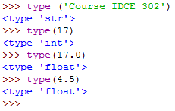
Built-in Functions
A function is a named group of code that is used to carry out a certain action. Using a function in a program is referred to as calling the function.
Python provides a set of core functions, referred to as the built-in functions, which we can call and use directly in any line of code.
We can view these functions within Python using the statement: print dir(__builtins__)
A more detailed description is provided in Python documentation: https://docs.python.org/2/library/functions.html#
Function call. The name of the function is type, and it displays the type of a value or variable.
The value or variable, which is called the argument of the function, has to be enclosed in parentheses.
It is common to say that a function “takes” an argument and “returns” a result. The result is called the return value.
Instead of printing the return value, we could assign it to a variable.

Slide 18
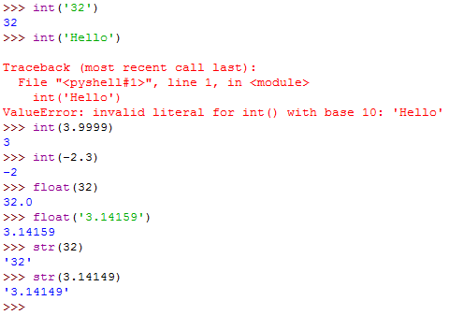
Type Conversion Functions
Python provides a collection of built-in functions that convert values from one type to another.
The int function takes any value (that is stored as string) and converts it to an integer, if possible, or complains otherwise (if the argument is a text string).
The int function can also convert floating-point values to integers, but it truncates the fractional part.
The float function converts integers and strings to floating-point numbers.
The str function converts to type string.

Slide 19
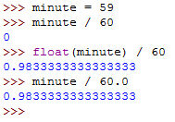
Type Coersion
To perform true division we can take advantage of the rules for automatic type conversion, which is called type coercion.
For the mathematical operators, if either operand is a float, the other is automatically converted to a float:

Slide 20
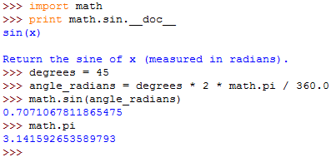
Math Module
A module is a file that contains a collection of related functions grouped together.
Python has a math module that provides most of the familiar mathematical functions.
Before we can use the functions from a module, we have to import the module using a special statement called import.
To call one of the functions, we have to specify the name of the module and the name of the function, separated by a dot, also known as a period.
This format is called dot notation.
sin and the other trigonometric functions (cos, tan, etc.) take arguments in radians.
To convert from degrees to radians, divide by 360 and multiply by 2*pi.
The constant pi is also part of the math module.

Slide 21
Function Definition
So far, we have only been using the functions that come with Python, but it is also possible to add new functions.
A function is a named sequence of statements that performs a computation.
The syntax for a function definition is: def Name( List of Parameters ): Statements
The first line of the function definition is called the header and has to end with a colon:
def is a keyword that indicates that this is a function definition.
Name of the function is specified following the same rules applied to naming variables.
List of Parameters specifies what information, if any, the user has to provide in order to use the new function.
The rest of the function is called the body and contains the sequence of statements that execute when the function is called.
There is no limitation in the number of statements.
The body has to be indented.

Slide 22
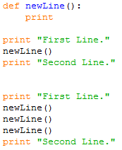
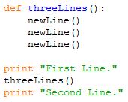
Example of Function Definition
This function is named newLine.
The empty parentheses indicate that it has no parameters.
It contains only a single statement, which outputs a newline character.
The function definition has to be executed before the first time it is called, but statements inside the function are not executed until the function is called.
The syntax for calling the new function is the same as the syntax for built-in functions.
You can call the same function repeatedly.
You can have one function call another function; in this case threeLines calls newLine.

Slide 23
Flow of Execution
Execution always begins at the first statement of the program. Statements are executed one at a time, in order from top to bottom.
Although it is not common, you can define one function inside another. In this case, the inner definition isn’t executed until the outer function is called.
Function calls are like a detour in the flow of execution.
When you read a program, don’t read from top to bottom. Instead, follow the flow of execution.

Slide 24
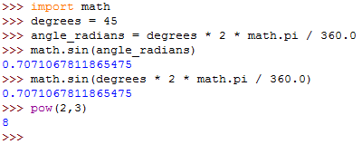
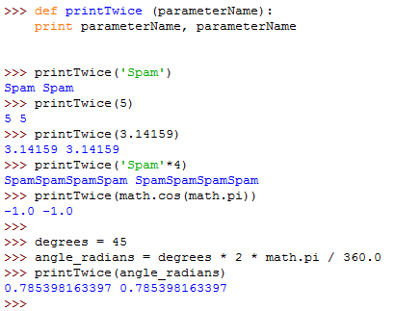
Parameters and Arguments
Some of the built-in functions require arguments, the values that control how the function does its job.
Some functions take more than one argument, such as pow() built-in function.
Any kind of expression can be used as an argument, such as one used for math.sin() built-in function.
Inside the function, the values that are passed get assigned to variables called parameters.
The name of the variable we pass as an argument (angle_radians) to the function we defined (printTwice) has nothing to do with the name of the parameter (parameterName).

